Slide 1
Using HashSet/HashMap

Slide 2
Sets
Set: Unordered collection of distinct elements
Elements can be added, located, and removed
Sets don’t have duplicates

Slide 3
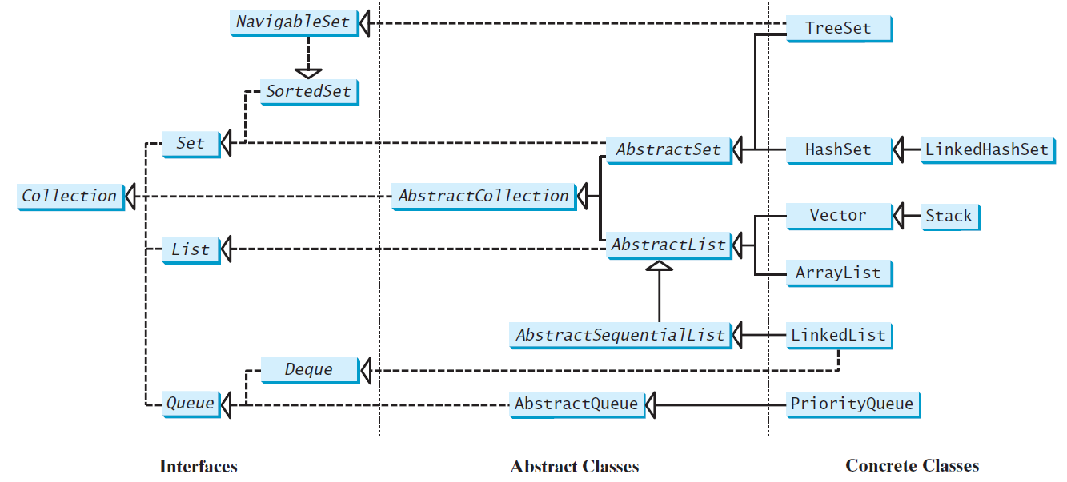
Review of Java Collection Framework hierarchy
Set and List are subinterfaces of Collection.

Slide 4
Fundamental Operations on a Set
Adding an element
Adding an element has no effect if the element is already in the set
Removing an element
Attempting to remove an element that isn’t in the set is silently ignored
Containment testing (Does the set contain a given object?)
Listing all elements (in arbitrary order)

Slide 5
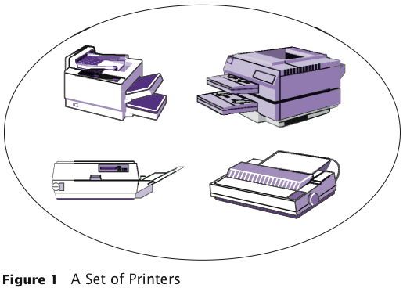
A Set of Printers
Big Java by Cay Horstmann
Copyright © 2009 by John Wiley & Sons. All rights reserved.

Slide 6
Sets
We could use a linked list to implement a set
Adding, removing, and containment testing would be relatively slow
There are data structures that can handle these operations much more quickly
Hash tables
Trees

Slide 7
Sets
Standard Java library provides set implementations based on both data structures
HashSet
TreeSet
Both of these data structures implement the Set interface
As a rule of thumb, use a hash set unless you want to visit the set elements in sorted order

Slide 8
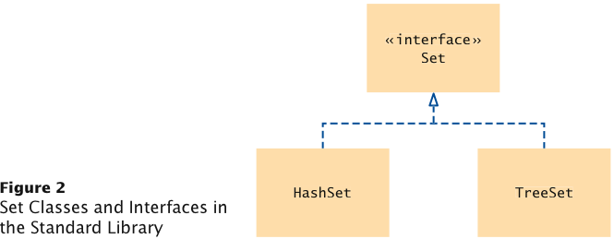
Set Classes and Interface in the Standard Library

Slide 9
Using a Set
Example: Using a set of strings
Construct the Set:
Set<String> names = new HashSet<String>();
or
Set<String> names = new TreeSet<String>();
Add and remove elements:
names.add("Romeo");
names.remove("Juliet");
Test whether an element is contained in the set:
if (names.contains("Juliet")) . . .

Slide 10
Iterator
Use an iterator to visit all elements in a set
A set iterator does not visit the elements in the order in which they were inserted
An element cannot be added to a set at an iterator position
A set element can be removed at an iterator position

Slide 11
Visiting All Elements with an Iterator
Iterator<String> iter = names.iterator(); while (iter.hasNext()) { String name = iter.next(); Do something with name }
or, using the “for each” loop:
for (String name : names) { Do something with name }

Slide 12
Set Test Program
Read in all words from a dictionary ﬁle that contains correctly spelled words and place them into a set
Read all words from a document into a second set — here, the book “Alice in Wonderland”
Print all words from that set that are not in the dictionary set — potential misspellings

Slide 13
ch16/spellcheck/SpellCheck.java
1 import java.util.HashSet;
2 import java.util.Scanner;
3 import java.util.Set;
4 import java.io.File;
5 import java.io.FileNotFoundException;
6
7 /**
8 This program checks which words in a file are not present in a dictionary.
9 */
10 public class SpellCheck
11 {
12 public static void main(String[] args)
13 throws FileNotFoundException
14 {
15 // Read the dictionary and the document
16
17 Set<String> dictionaryWords = readWords("words");
18 Set<String> documentWords = readWords("alice30.txt");
19
Continued

Slide 14
ch16/spellcheck/SpellCheck.java (cont.)
15 // Read the dictionary and the document
16
17 Set<String> dictionaryWords = readWords("words");
18 Set<String> documentWords = readWords("alice30.txt");
19
20 // Print all words that are in the document but not the dictionary
21
22 for (String word : documentWords)
23 {
24 if (!dictionaryWords.contains(word))
25 {
26 System.out.println(word);
27 }
28 }
29 }
30
Continued

Slide 15
ch16/spellcheck/SpellCheck.java (cont.)
31 /**
32 Reads all words from a file.
33 @param filename the name of the file
34 @return a set with all lowercased words in the file. Here, a
35 word is a sequence of upper- and lowercase letters.
36 */
37 public static Set<String> readWords(String filename)
38 throws FileNotFoundException
39 {
40 Set<String> words = new HashSet<String>();
41 Scanner in = new Scanner(new File(filename));
42 // Use any characters other than a-z or A-Z as delimiters
43 in.useDelimiter("[^a-zA-Z]+");
44 while (in.hasNext())
45 {
46 words.add(in.next().toLowerCase());
47 }
48 return words;
49 }
50 }
Continued

Slide 16
ch16/spellcheck/SpellCheck.java (cont.)
Program Run:
neighbouring
croqueted
pennyworth
dutchess
comfits
xii
dinn
clamour
...

Slide 17
Self Check 16.1
Arrays and lists remember the order in which you added elements; sets do not. Why would you want to use a set instead of an array or list?
Answer: Efficient set implementations can quickly test whether a given element is a member of the set.

Slide 18
Self Check 16.2
Why are set iterators different from list iterators?
Answer: Sets do not have an ordering, so it doesn’t make sense to add an element at a particular iterator position, or to traverse a set backwards.

Slide 19
Self Check 16.4
When would you choose a tree set over a hash set?
Answer: When it is desirable to visit the set elements in sorted order.

Slide 20
Maps
A map keeps associations between key and value objects
Mathematically speaking, a map is a function from one set, the key set, to another set, the value set
Every key in a map has a unique value
A value may be associated with several keys
Classes that implement the Map interface
HashMap
TreeMap
Both of these data structures implement the Map interface
As a rule of thumb, use a hash set unless you want to visit the set elements in sorted order

Slide 21
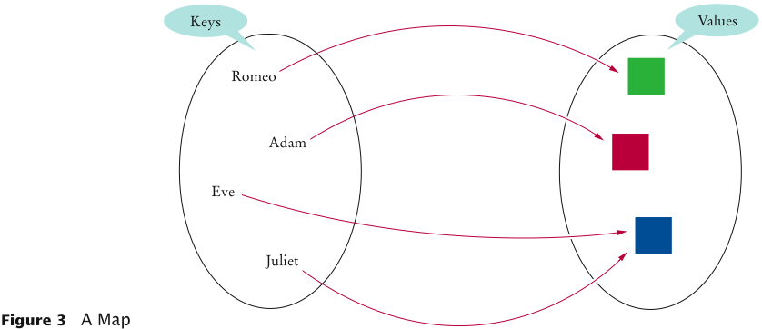
An Example of a Map
Big Java by Cay Horstmann
Copyright © 2009 by John Wiley & Sons. All rights reserved.

Slide 22
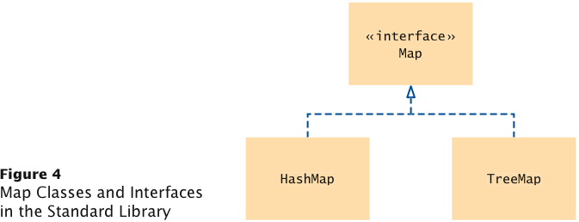
Map Classes and Interfaces

Slide 23
Using a Map
Example: Associate names with colors
Construct the Map:
Map<String, Color> favoriteColors =
new HashMap<String, Color>();
or
Map<String, Color> favoriteColors =
new TreeMap<String, Color>();
Add an association:
favoriteColors.put("Juliet", Color.RED);
Change an existing association:
favoriteColors.put("Juliet",Color.BLUE);

Slide 24
Using a Map
Get the value associated with a key:
Color julietsFavoriteColor =
favoriteColors.get("Juliet”);
Remove a key and its associated value:
favoriteColors.remove("Juliet");

Slide 25
Printing Key/Value Pairs
Set<String> keySet = m.keySet(); for (String key : keySet) { Color value = m.get(key); System.out.println(key + ” : " + value); }

Slide 26
ch16/map/MapDemo.java
1 import java.awt.Color;
2 import java.util.HashMap;
3 import java.util.Map;
4 import java.util.Set;
5
6 /**
7 This program demonstrates a map that maps names to colors.
8 */
9 public class MapDemo
10 {
11 public static void main(String[] args)
12 {
13 Map<String, Color> favoriteColors = new HashMap<String, Color>();
14 favoriteColors.put("Juliet", Color.BLUE);
15 favoriteColors.put("Romeo", Color.GREEN);
16 favoriteColors.put("Adam", Color.RED);
17 favoriteColors.put("Eve", Color.BLUE);
18
Continued

Slide 27
ch16/map/MapDemo.java (cont.)
19 // Print all keys and values in the map
20
21 Set<String> keySet = favoriteColors.keySet();
22 for (String key : keySet)
23 {
24 Color value = favoriteColors.get(key);
25 System.out.println(key + " : " + value);
26 }
27 }
28 }
Program Run:
Romeo : java.awt.Color[r=0,g=255,b=0]
Eve : java.awt.Color[r=0,g=0,b=255]
Adam : java.awt.Color[r=255,g=0,b=0]
Juliet : java.awt.Color[r=0,g=0,b=255]
Continued

Slide 28
Self Check 16.5
What is the difference between a set and a map?
Answer: A set stores elements. A map stores associations between keys and values.

Slide 29
Self Check 16.6
Why is the collection of the keys of a map a set?
Answer: The ordering does not matter, and you cannot have duplicates.

Slide 30
Performance of a List-Based Map
Performance:
put takes O(1) time if we assume can insert the new item at the beginning or at the end of the sequence. However, a put may replace, so it is really O(n).
get and remove take O(n) time since in the worst case (the item is not found) we traverse the entire sequence to look for an item with the given key
The unsorted list implementation is effective only for maps of small size or for maps in which puts are the most common operations, while searches and removals are rarely performed (e.g., historical record of logins to a workstation)

Slide 31
Implementing a HashMap
When implementing a HashMap, you can either assume that compression is done in the class hashCode() method or do it in the HashMap
Why compress?
Without compression a hashMap must support up to 2³² different table indices- not efficient at all

Slide 32
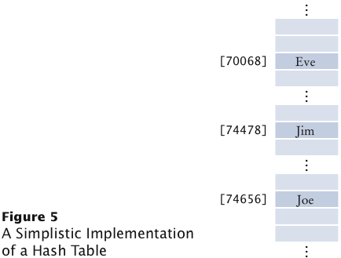
Simplistic implementation of Hash Map
Problems with this implementation:
It is not possible to allocate an array that is large enough to hold all possible integer index positions
It is possible for two different objects to have the same hash code

Slide 33
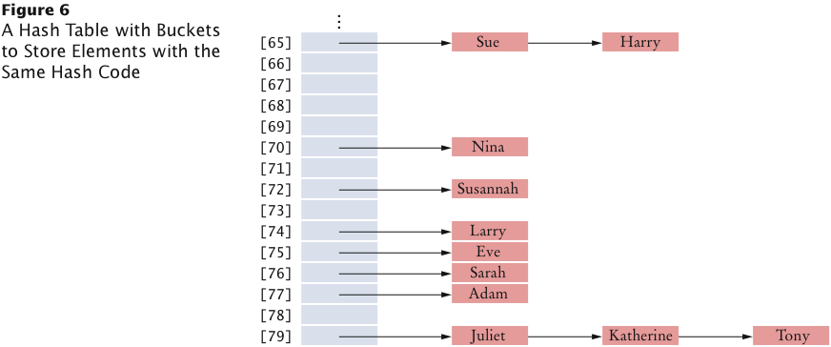
Hash Table with Buckets to Store Elements with Same Hash Code
HashSet.java and HashSetDemo.java

Slide 34
HashSet.java
In this implementation, the hashCode is used to determine which array indices to place the object.
At each array indices, there is a linked list of all objects with that same compressed hashCode

Slide 35
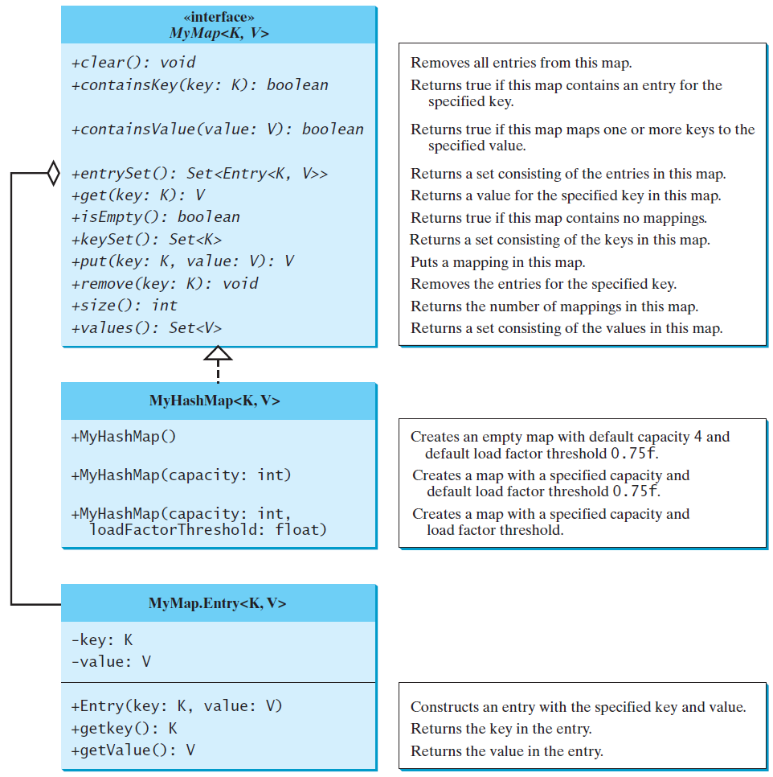
Implementing Map Using Hashing
MyMap
MyHashMap
TestMyHashMap
Run

Slide 36
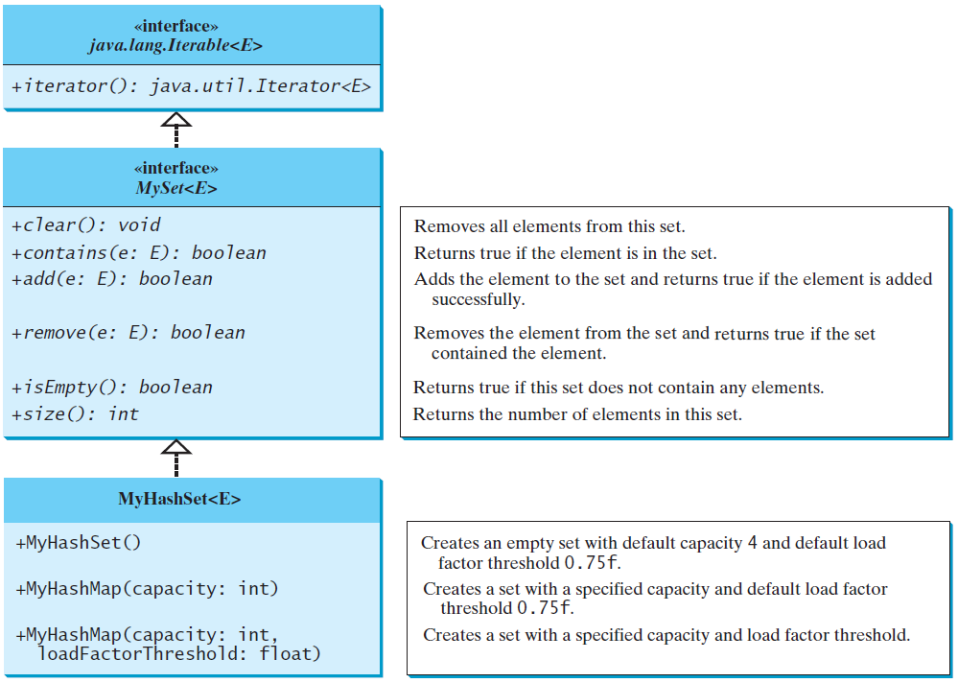
Implementing Set Using Hashing
MySet
MyHashSet
TestMyHashSet
Run

Slide 37
Hashing Performance
In the worst case, searches, insertions and removals on a hash table take O(n) time
The worst case occurs when all the keys inserted into the map collide
Applications of hash tables:
small databases
compilers
browser caches

